Slide 1
.NET Framework 4.0 – Changes & Benefits
www.otssolutions.com

Slide 2
Agenda
Overview of .NET Framework
.NET Framework History
.NET Framework Benefits
.NET Framework 4 Architecture

Slide 3
1
Overview of .NET framework

Slide 4
Overview of the .NET Framework
The .NET Framework is a new computing platform that simplifies application development in the highly distributed environment of the Internet.
ASP.NET is a web application framework developed and marketed by Microsoft to allow programmers to build dynamic websites, web applications and web services.

Slide 5
Overview of the .NET Framework
Common Language Runtime – provides an abstraction layer over the operating system.
Base Class Libraries – pre-built code for common low-level programming tasks.
Development frameworks and technologies – reusable, customizable solutions for larger programming tasks.

Slide 6
2
.NET Framework History

Slide 7
.NET Framework History
SP1
3.5
3.0
.NET 1.0
.NET 1.1
.NET 2.0
.NET 4
2002
2003
2005-08
2008 CTP
CLR 1.0
CLR 1.1
CLR 2.0
CLR 4
Notes:
CTP : community technology preview

Slide 8
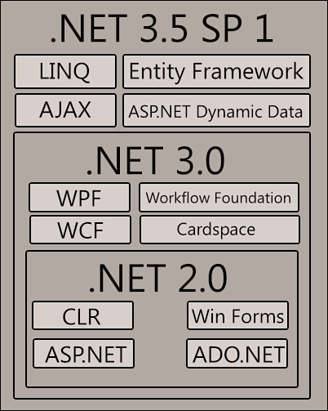
Incremental Architecture Of.NET 3.5 SP1
.NET Framework History

Slide 9
3
.NET Framework Benefits

Slide 10
The .NET Framework Benefits:
Apply common skills across a variety of devices, application types, and programming tasks
The .NET Framework helps software developers and systems administrators more easily build and maintain systems with improvements toward performance, security, and reliability.

Slide 11
The .NET Framework Benefits:
Most consumers will never notice that the .NET Framework is running on their Pocket PC, Smartphone, or desktop computer. But they may appreciate the reliability, ease of use, and ability to connect to other systems that the .NET Framework helps bring to computers.
Build compelling applications faster.
Integrate with other tools and technologies to build the right solution with less work.

Slide 12
The .NET Framework Benefits:
The .NET Framework will enable developers to develop applications for various devices and platforms like windows application web applications windows services and web services.
Tools for developing software applications, run-time environments for software application to execute, server infrastructure, value added intelligent software which helps developers to do less coding and work efficiently.

Slide 13
The .NET Framework Benefits:
The .NET Compact Framework version 3.5 expands support for distributed mobile applications by including the Windows Communication Foundation (WCF) technology. It also adds new language features such as LINQ, new APIs based on community feedback, and improves debugging with updated diagnostic tools and features.

Slide 14
4
.NET Framework 4 Architecture

Slide 15
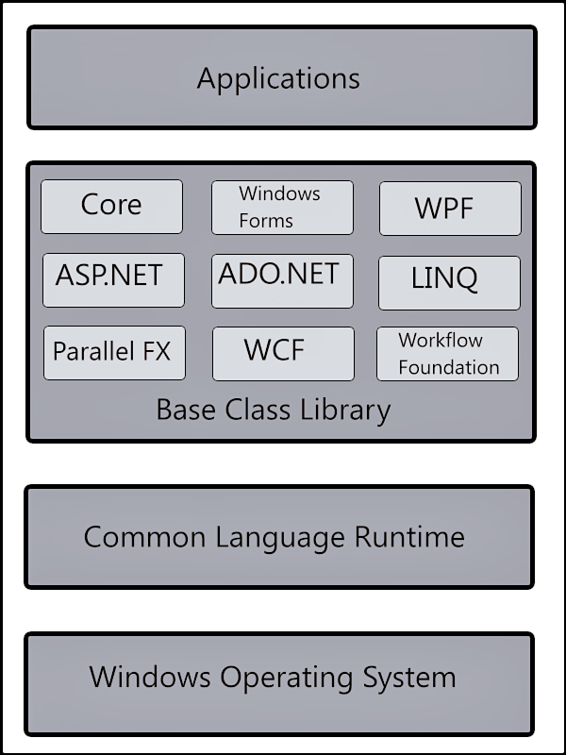
.NET Framework 4 Architecture

Slide 16
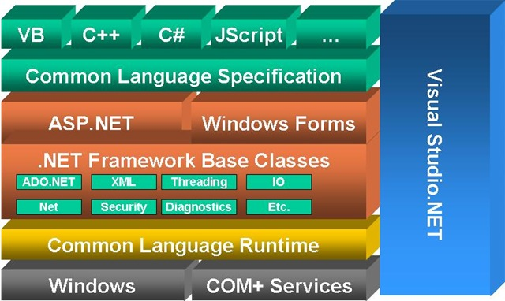
.NET Framework 4 Architecture

Slide 17
Thank You

Slide 18
USA
4433 Merlin
Way , Soquel
CA 95073
United States
Ph: +1 408 540 0001
Write to us at: sales@otssolutions.com
United kingdom
88 Wood Street
10th Floor London
EC2V 7RS
Ph: +44 208 099 1660
Write to us at: sales@otssolutions.com
India
Gurgaon ( Haryana )
795, Udyog Vihar, Phase-V
Gurgaon(Haryana) India
Ph: +91 124 4101350
+91 124 4748100
Write to us at: sales@otssolutions.com
http://www.otssolutions.com/

